Slide 1


Programing Workshop For Beginners
1399 - 1400

Slide 2
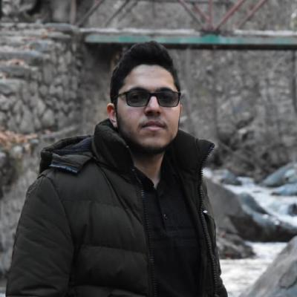
کافه آیوتی
Computer graduate [network computer]
Thesis title: Designe, Implementation and Evaluation of an Object Tracking system based on LPWAN
Paper:
J. Babaki, M. Rasti and R. Aslani, "Dynamic Spreading Factor and Power Allocation of LoRa Networks for Dense IoT Deployments," 2020 IEEE 31st Annual International Symposium on Personal, Indoor and Mobile Radio Communications, London, United Kingdom, 2020, pp. 1-6, doi: 10.1109/PIMRC48278.2020.9217283. [IEEE]
IT manger in Modat Institute
IoT Laboratory director in inotec

Slide 3
انگیزه کافی داشته باشیم
به هم اعتماد کافی داشته باشیم و هماهنگ باشیم
وقت کافی برای دانشجوها بذاریم

Slide 4

THANK YOU!
FOR YOUR ATTENTION

